Slide 1
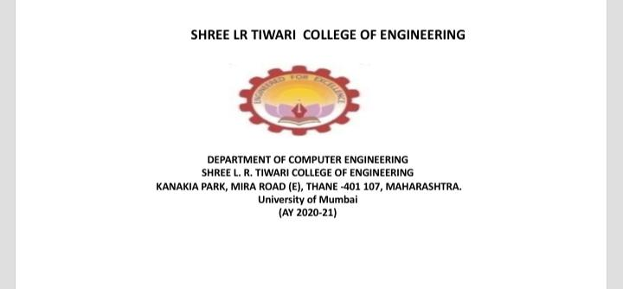

Slide 2
OPERATING SYSTEM MINI PROJECT
MADE BY : HITESH MEWADA, ROLL NO 30
AND YASH MITTAL, ROLL NO 33
GUIDE NAME : PROF. DEEPALI BHOLE
TOPIC : DEADLOCK DETECTION
SE-CMPN,
SHREE L.R TIWARI COLLEGE OF ENGINEERING.

Slide 3
DESCRIPTION :
Deadlock detection is the process of actually determining that a deadlock exists and identifying the processes and resources involved in the deadlock.
Once a deadlock is detected, there needs to be a way to recover several alternatives exists.
Temporarily prevent resources from deadlocked processes

Slide 4
WHAT IS DEADLOCK.??
In an operating system, a deadlock occurs when a process or thread enters a waiting state because a requested system resource is held by another waiting process, which in turn is waiting for another resource held by another waiting process.

Slide 5
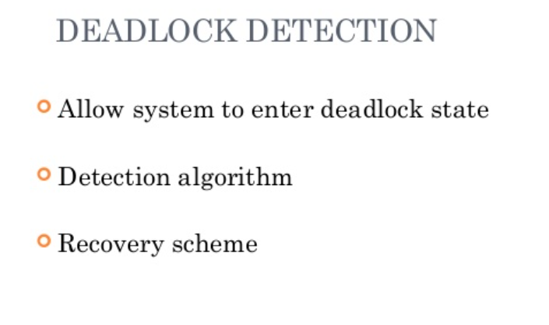

Slide 6
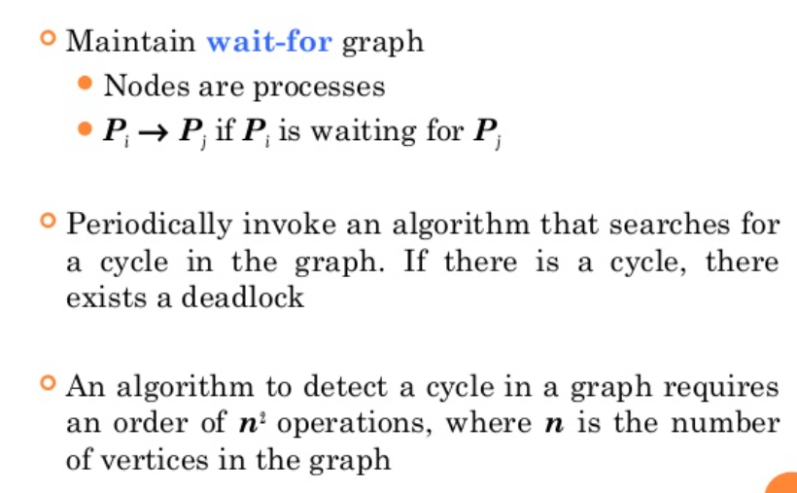
Single instance of each resources type

Slide 7
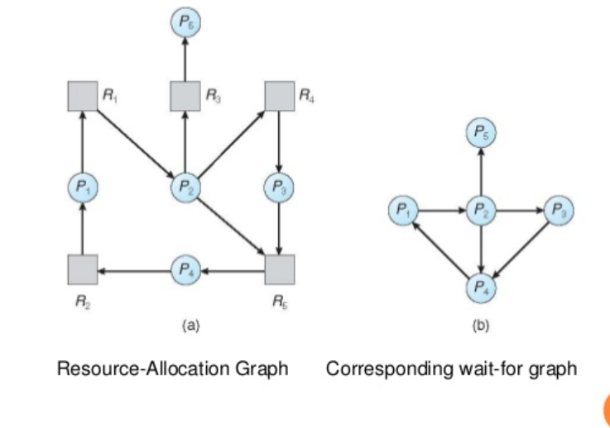
RESOURCE ALLOCATION GRAPH AND WAIT FOR GRAPH

Slide 8
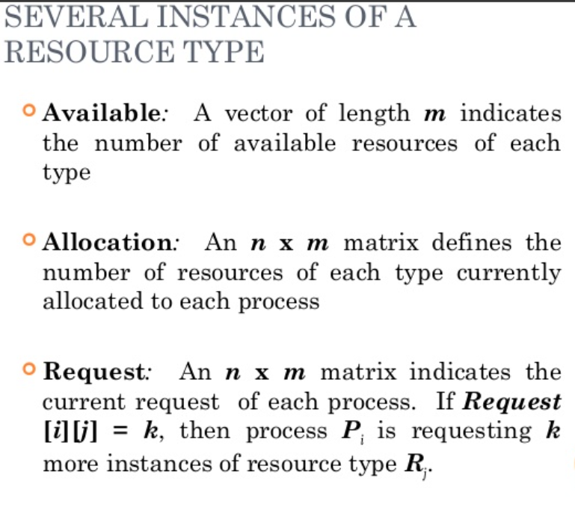

Slide 9
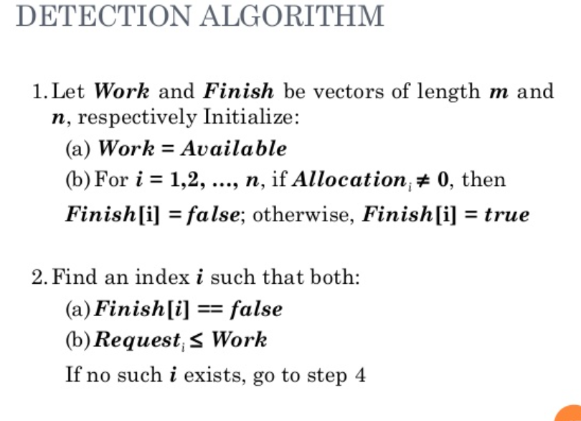

Slide 10
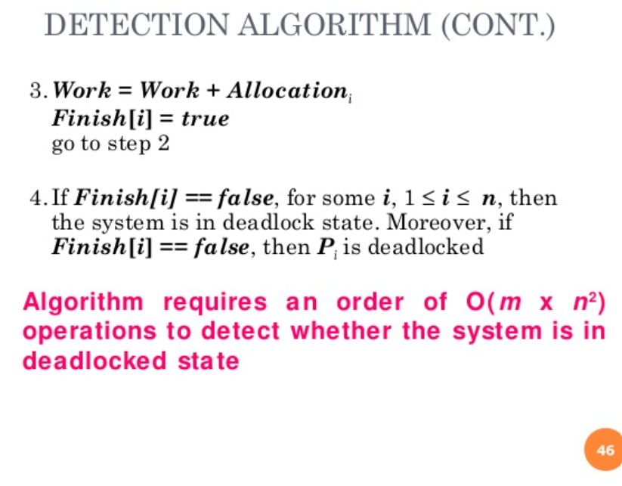

Slide 11
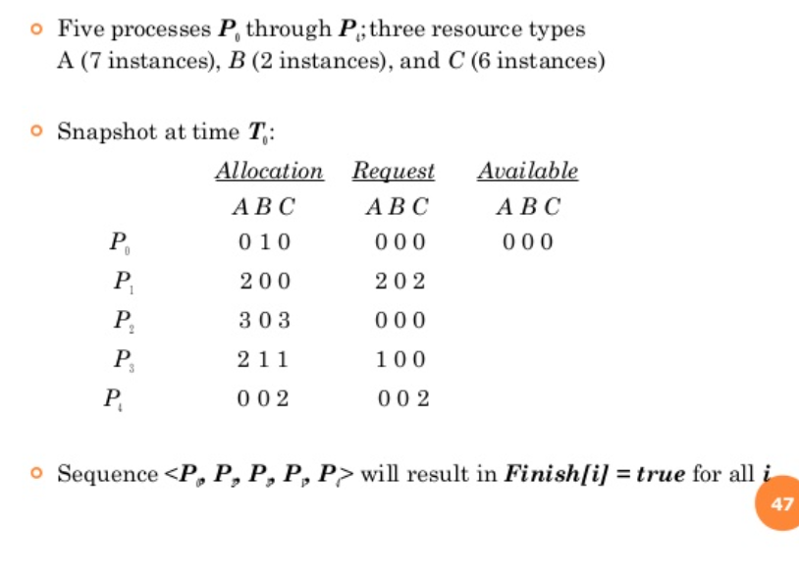
EXAMPLE OF DETECTION ALGORITHM

Slide 12
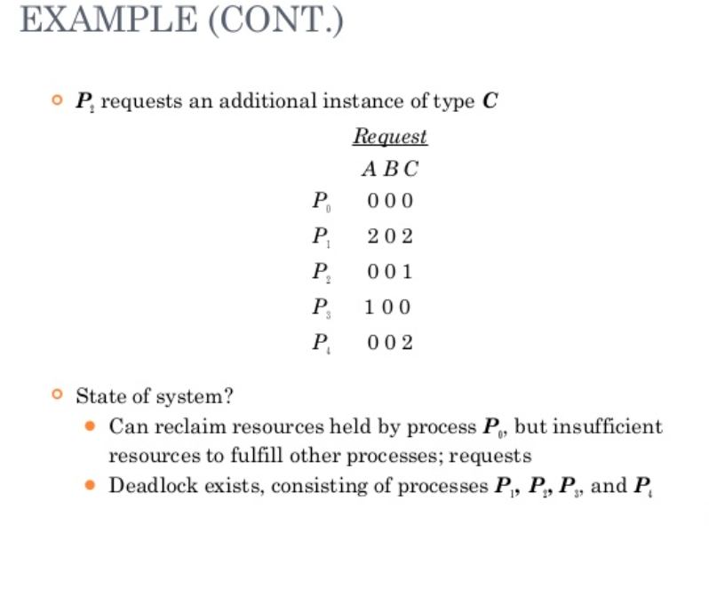

Slide 13
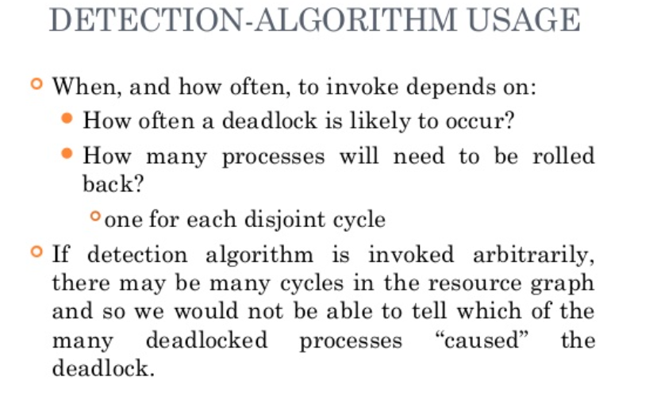

Slide 14
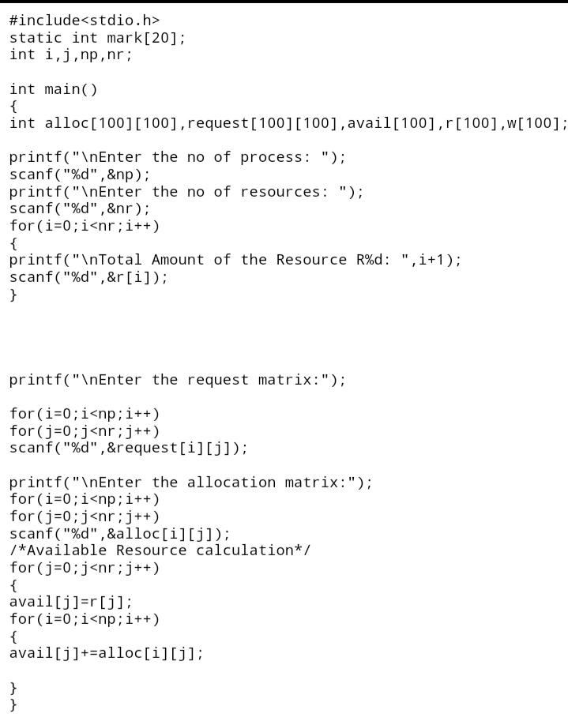

Slide 15
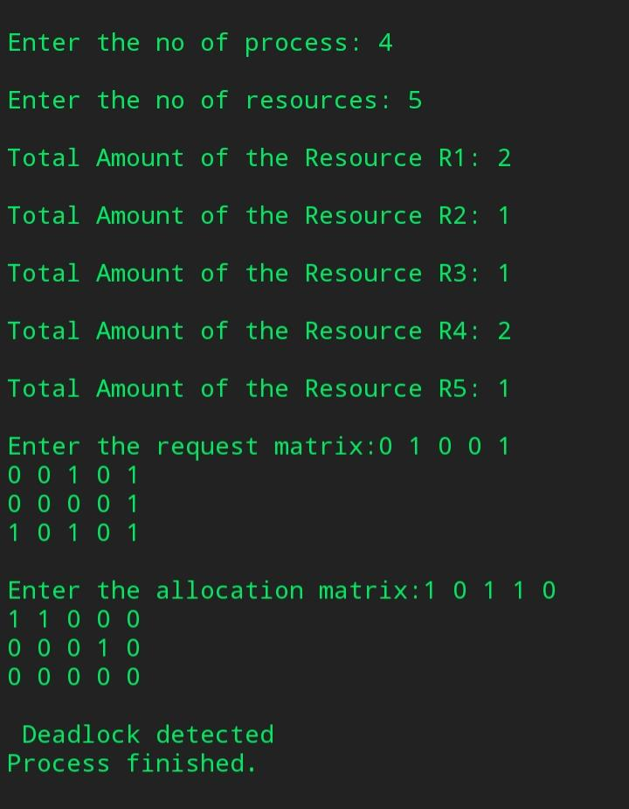

Slide 16
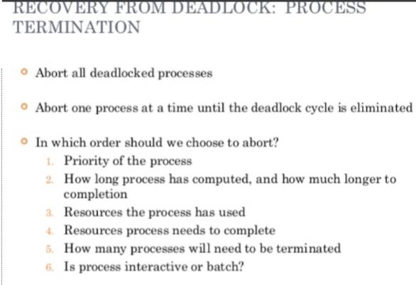

Slide 17
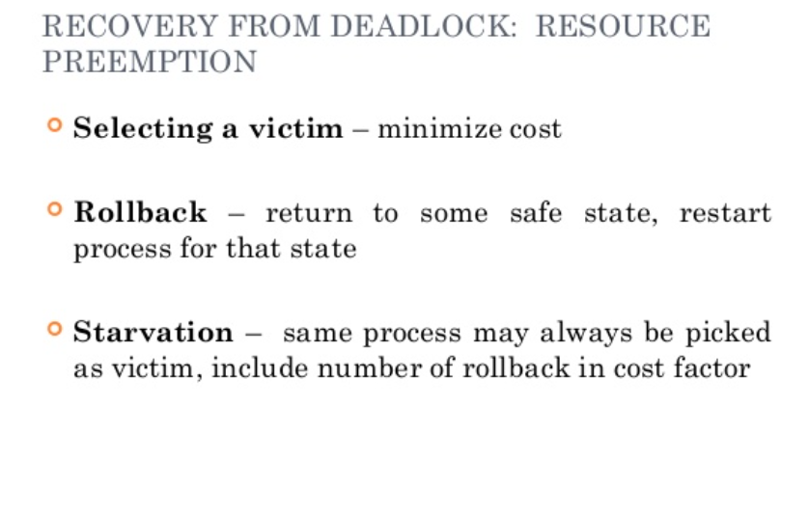

Slide 18
THANK YOU

